Slide 1


Dolphin Health Monitoring: DoliMo App

Slide 2

Agenda and Overview of Project
Content Topic and Members
01
Introduction to Project; App Login, Sign-up, Registration - Jagyaseni Das
02
Frontend Language Framework and Overview - Constantin Wolff
03
Ionic Vue Framework, UI and User Journey - Ishitha Padmaraju
04
Backend Data Structure - Andreas Hierl
05
Backend Tables and Framework - Daniel Sakarli
06
Backend API and Overall Structure - Ziqi He

Slide 3
DoliMo – Dolphin Monitoring
Introduction to the Project
Project: DoliMo - Dolphin Monitoring, a project for the Nuremberg Zoo.
Goal: Develop an app to make workflow of evaluating health status of Dolphins in the Nuremberg Zoo as simple and intuitive as possible.
Digitally store all collected data directly on site and to guide the persons step by step through the evaluation.
This app enables a visualization of the measured data to show possible health changes of Dolphins over time.
Step-by-step guide through the evaluation of the Dolphins themselves.
App evaluates data in order to make analyses and forecasts about well-being of Dolphins.
Evaluation Principles
Good
Feeding
Appropriate
Behaviour
Good
Housing
Good Health
Emotional
State

Slide 4
App Login, Sign-up and Registration Frontend Language Framework and Overview Ionic Vue Framework, UI and User Journey

Slide 5
Jagyaseni Das App Login, Sign-up and Registration

Slide 6
App Login, Sign-up and Registration
How Ionic Vue is used and implemented
We are using Ionic Vue to create:
Login Page
Login Form page
Sign up Page
Implementation of Ionic Vue and coding:
From Ionic Vue library we are using UI components like template, ion card content, ion icon etc.
TypeScript used for creating Login Form, Login and Signup pages.

Slide 7
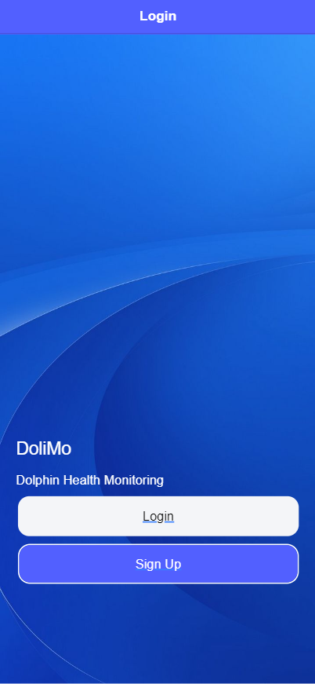
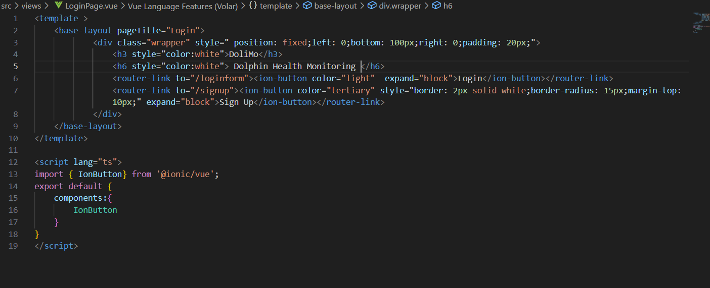

Slide 8
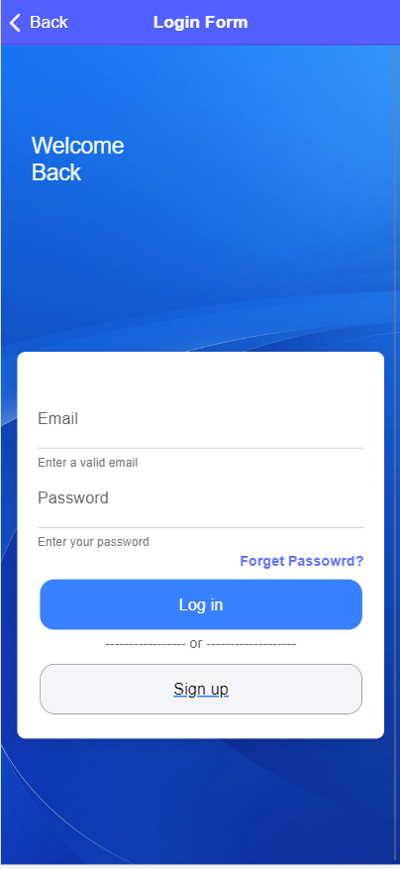
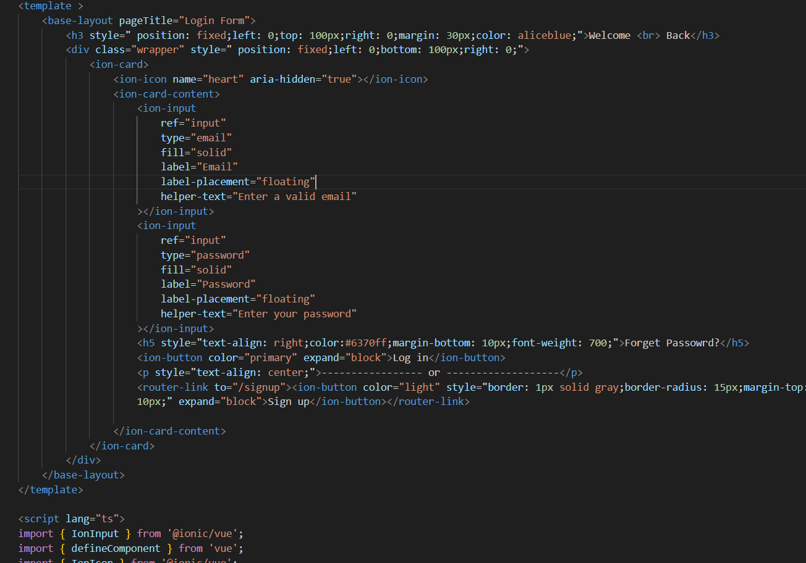

Slide 9
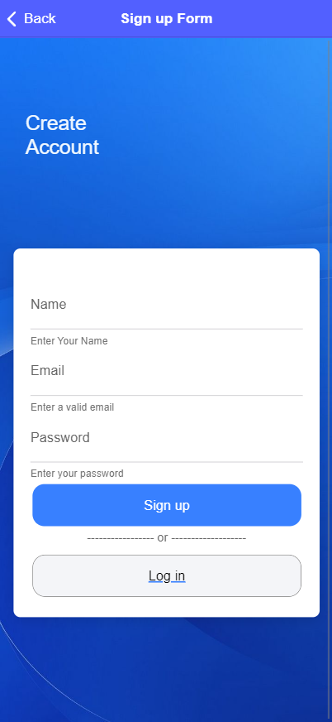
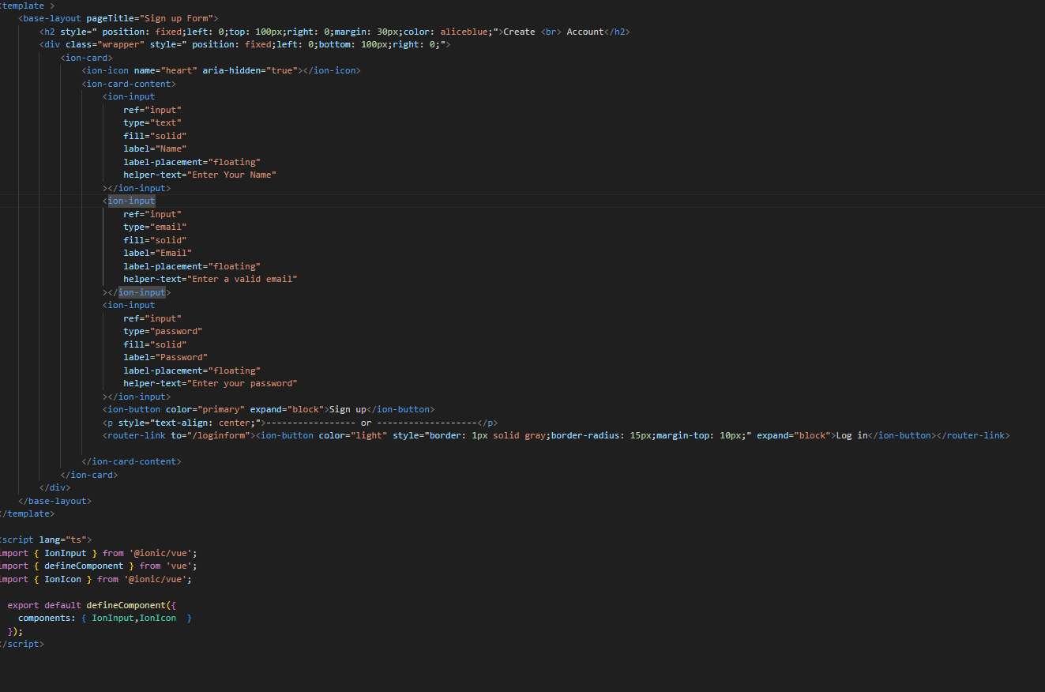

Slide 10
Constantin Wolff Frontend Language Framework and Overview

Slide 11
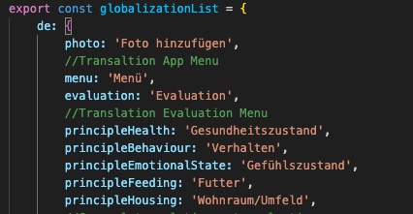
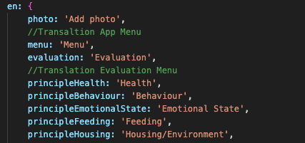
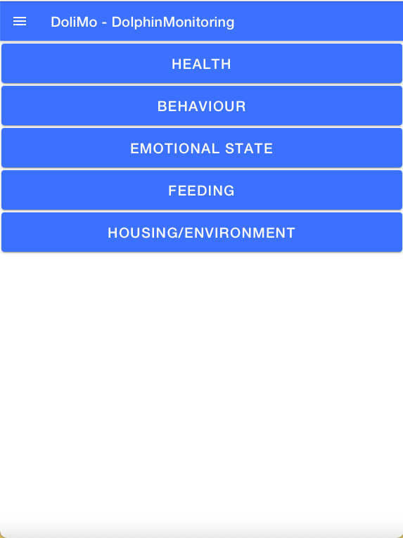
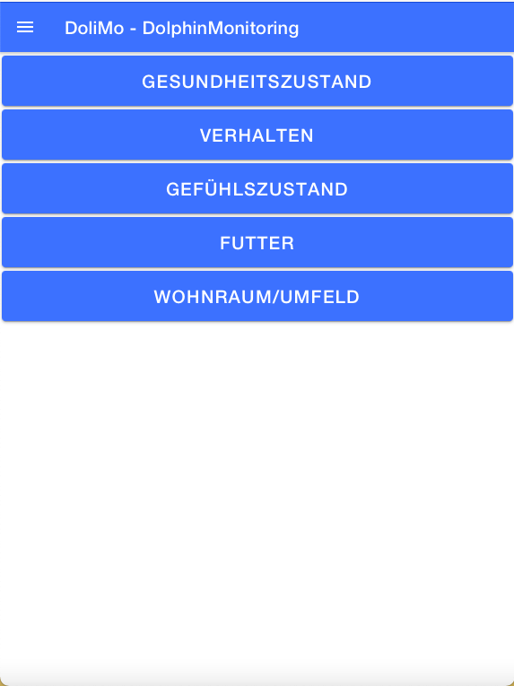
DoliMo – Dolphin Monitoring
Framework for multilingual support
Framework: Language detection takes place automatically by detecting the phones language settings
Pre-translated JSON file (stores translations of all the app’s text)
Translation is typed in manually for every string in code
English and german supported → Animal keepers who are maybe not fluent in English can use the app as well
Part from JSON file with app’s translations
Homepage of the App - English
Homepage of the App - German

Slide 12
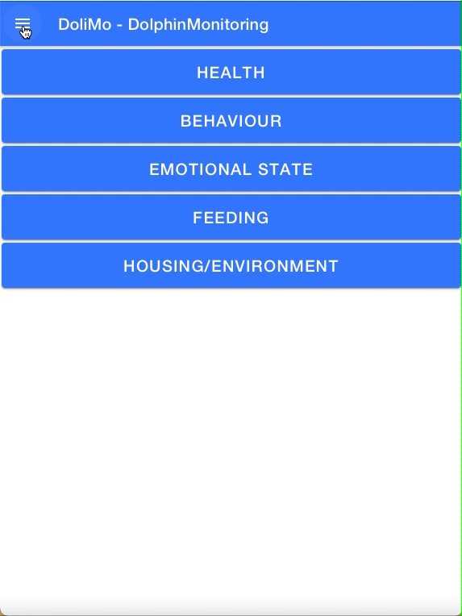
DoliMo – Dolphin Monitoring
How does the App look like?
5 Evaluation Principles
Housing / Environment
Health
Behaviour
Feeding
Emotional State
Criteria
Criteria
Criteria
Criteria
Criteria
Subcriteria
Subcriteria
Subcriteria
Subcriteria
Subcriteria
Every subcriteria stands for a test
App shall be developed to be as simple as possbile to handle
It has to fit to the workflow on site

Slide 13
Ishitha Padmaraju Ionic Vue Framework, UI and User Journey

Slide 14

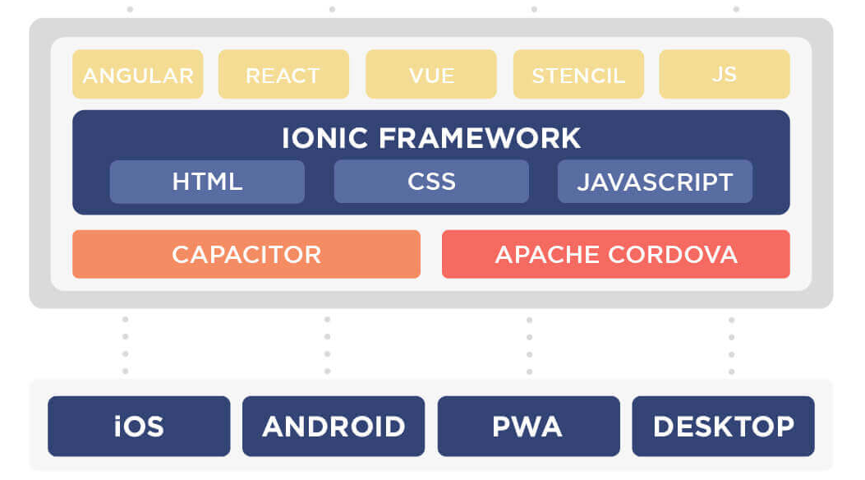
Ionic Vue Framework
Adoptation
Introduction
Ionic & Vue.js
Interactive
Performance-Optimised
Attractive UI
Component-Based Achitecture
Reuseable Components
Maintainable Codebase
Uniform Look and Feel
Ionic Capacitor
Native SDKs on iOS, Android and web
Consistency
Quick Development Time
Ionic UI Components
Pre-made UI Components
Consistent Design
Multi-Lingual Support
Vuei18n
App interface translation

Slide 15
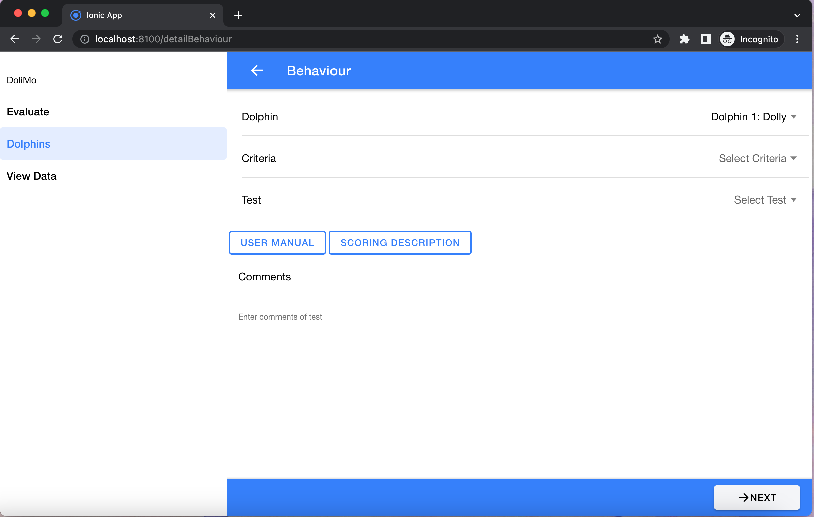
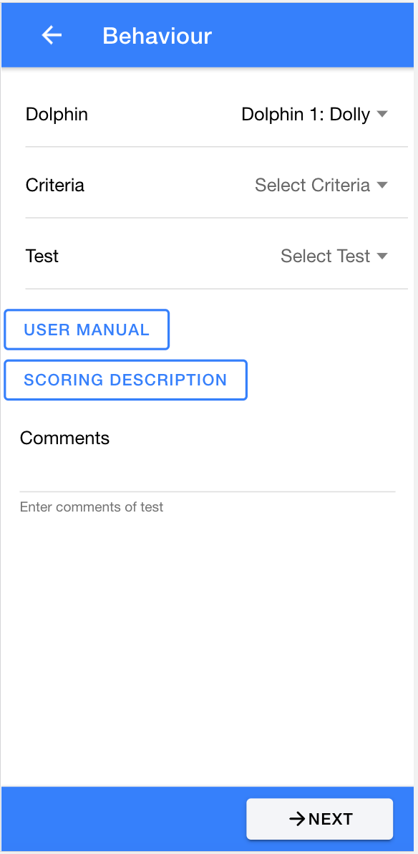
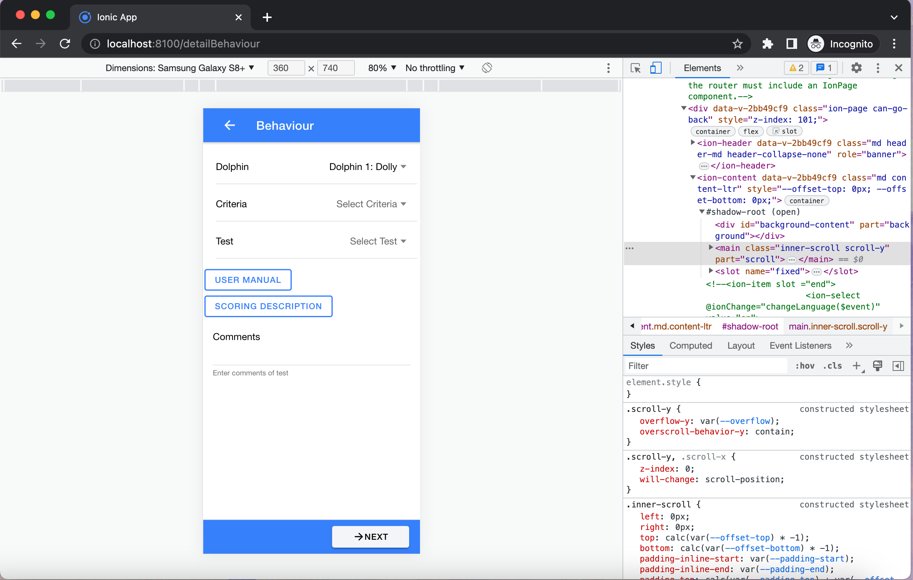
Ionic Vue UI
Desktop and Mobile Views of the App
Desktop site
Mobile site

Slide 16
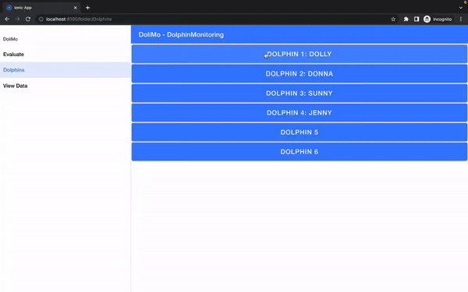
User Journey in DoliMo App
From the Selection of Dolphin to Saving Data
Step 1: Select the Dolphin
Step 2: Select the Principle
Step 3: Select the Criteria
Step 4: Select the Test
Step 5: Check the User Manual
Step 6: Check the Scoring Description
Step 7: Add Comments (if necessary)
Step 8: Proceed to the Next Page

Slide 17
Backend Data Structure Tables and Framework API and Overall Structure

Slide 18
Andreas Hierl Backend Data Structure

Slide 19
Structure given by the Tiergarten
WET System developed by Tiergarten: Structured into five Categories
Good feeding
Good housing
Good health
Appropriate behaviour
Adequate emotional state
Translated into ten tables in the Database
Good feeding
Good housing
Good health
Appropriate behaviour
Emotional state
Dolphins
Dolphin variables
Calculated Data
Users
Laboratory data

Slide 20
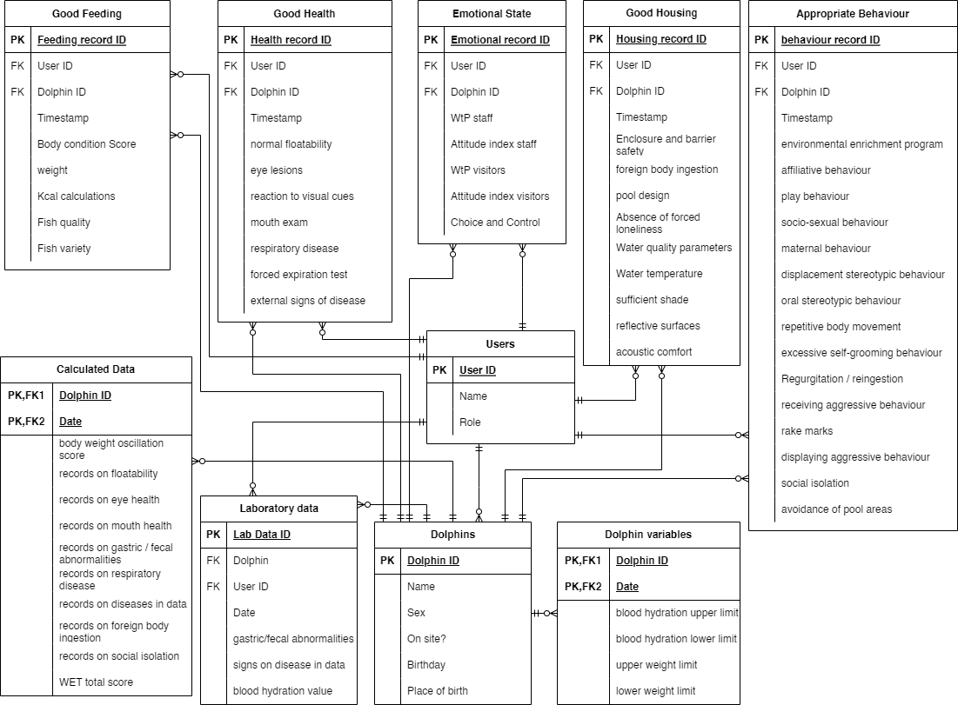

Slide 21
Daniel Sakarli Backend Tables and Framework

Slide 22
Tables
Why do we need them and what do they do?
Backend tables save:
Data
Pictures
Files
And everything that can be accessed by the frontend
The tables themselves will not be able to fulfill any function!
Notes:
- tables --> containing all
the backend information
- what is backend

Slide 23
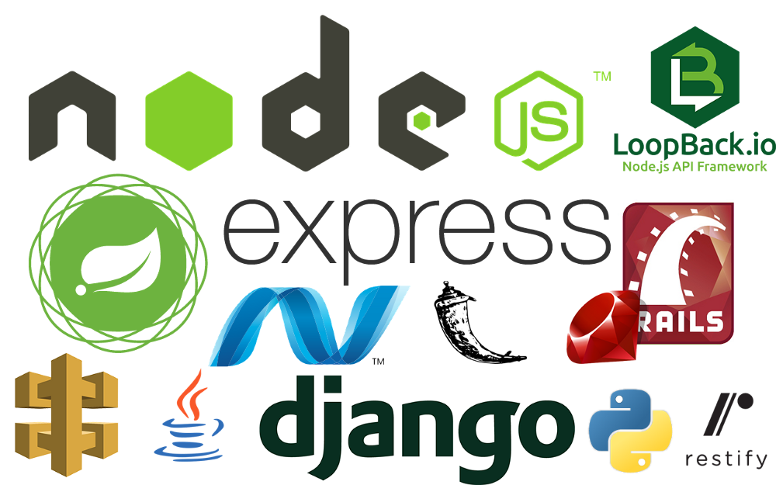
Backend Framework
What do they do and why should we use them?
Simpler backend development
Help in different ways (libraries, tools, etc.)
Framework used: Carecentive
Source: https://images.squarespace-cdn.com/content/v1/60794dbc8615125d3ad57026/0a31f0f1-016d-4c3e-b2bb-44a7f3f9d403/1_0ijZkEXCJZEO4izjTTGAYQ.png

Slide 24
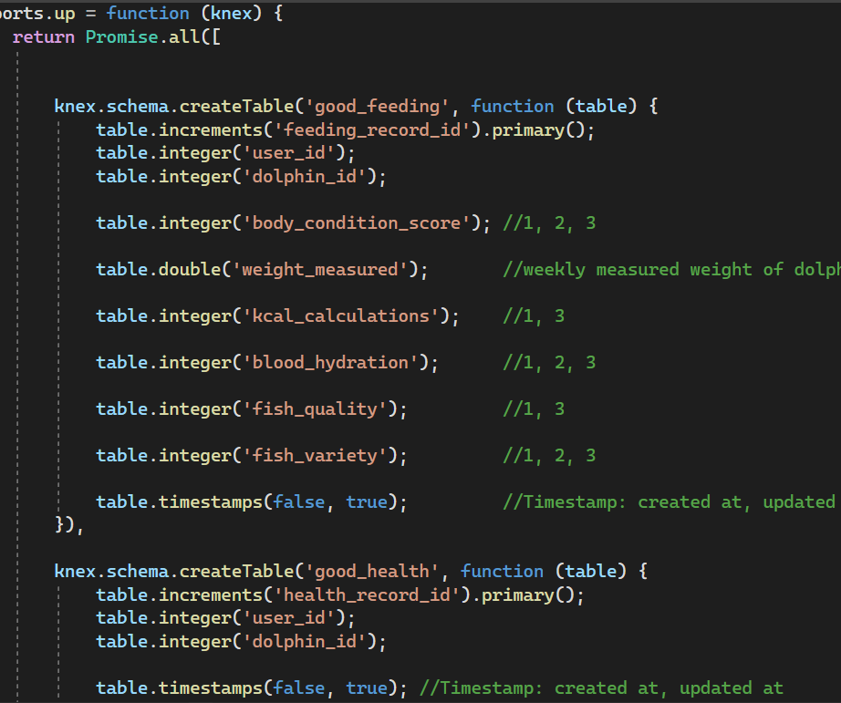
Carecentive
Tables are created or deleted via migrations
Migrations: Javascript files
Notes:
- Explain what migrations are (like the „versions“ of the app)

Slide 25
Ziqi He Backend API and Overall Structure

Slide 26
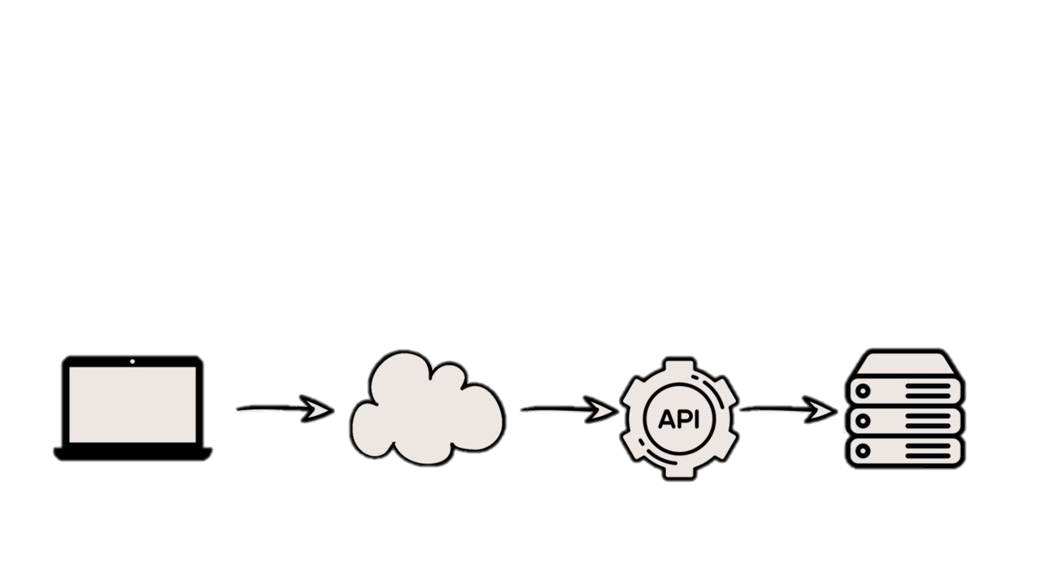
Dolphin Wet API
What is API?
Application Programming Interface
Client
Internet
Server
Source: https://www.youtube.com/watch?v=xjigCDPmvIk
Notes:
API stands for application programming interface, which is a set of definitions and protocols for building and integrating application software.
APIs let your product or service communicate with other products and services without having to know how they’re implemented. This can simplify app development, saving time and money.
In Dolimo, we build dolphin wet api to support our mobile application. But this isn’t restricted to current mobile app. In the future, any client interface can integrate this api e.g a web application of analysis dashboard. This provides more flexibility, avalibility

Slide 27
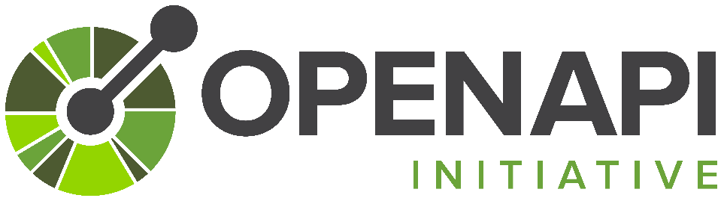
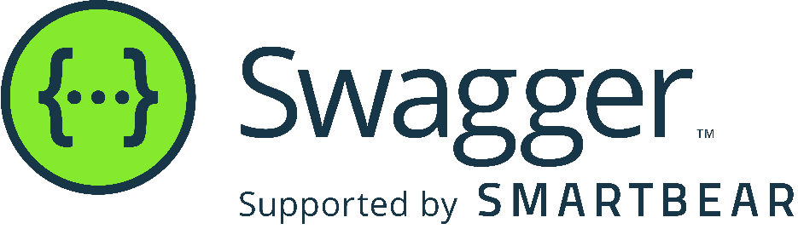
Dolphin Wet API
API documentation in DOLIMO
Source: https://swagger.io
https://swagger.io/resources/open-api/
Notes:
The OpenAPI Specification was donated to the Linux Foundation under the OpenAPI Initiative in 2015. The specification creates a RESTful interface for easily developing and consuming an API by effectively mapping all the resources and operations associated with it.
Swagger UI allows anyone — be it your development team or your end consumers — to visualize and interact with the API’s resources without having any of the implementation logic in place. It’s automatically generated from your OpenAPI (formerly known as Swagger) Specification, with the visual documentation making it easy for back end implementation and client side consumption.

Slide 28
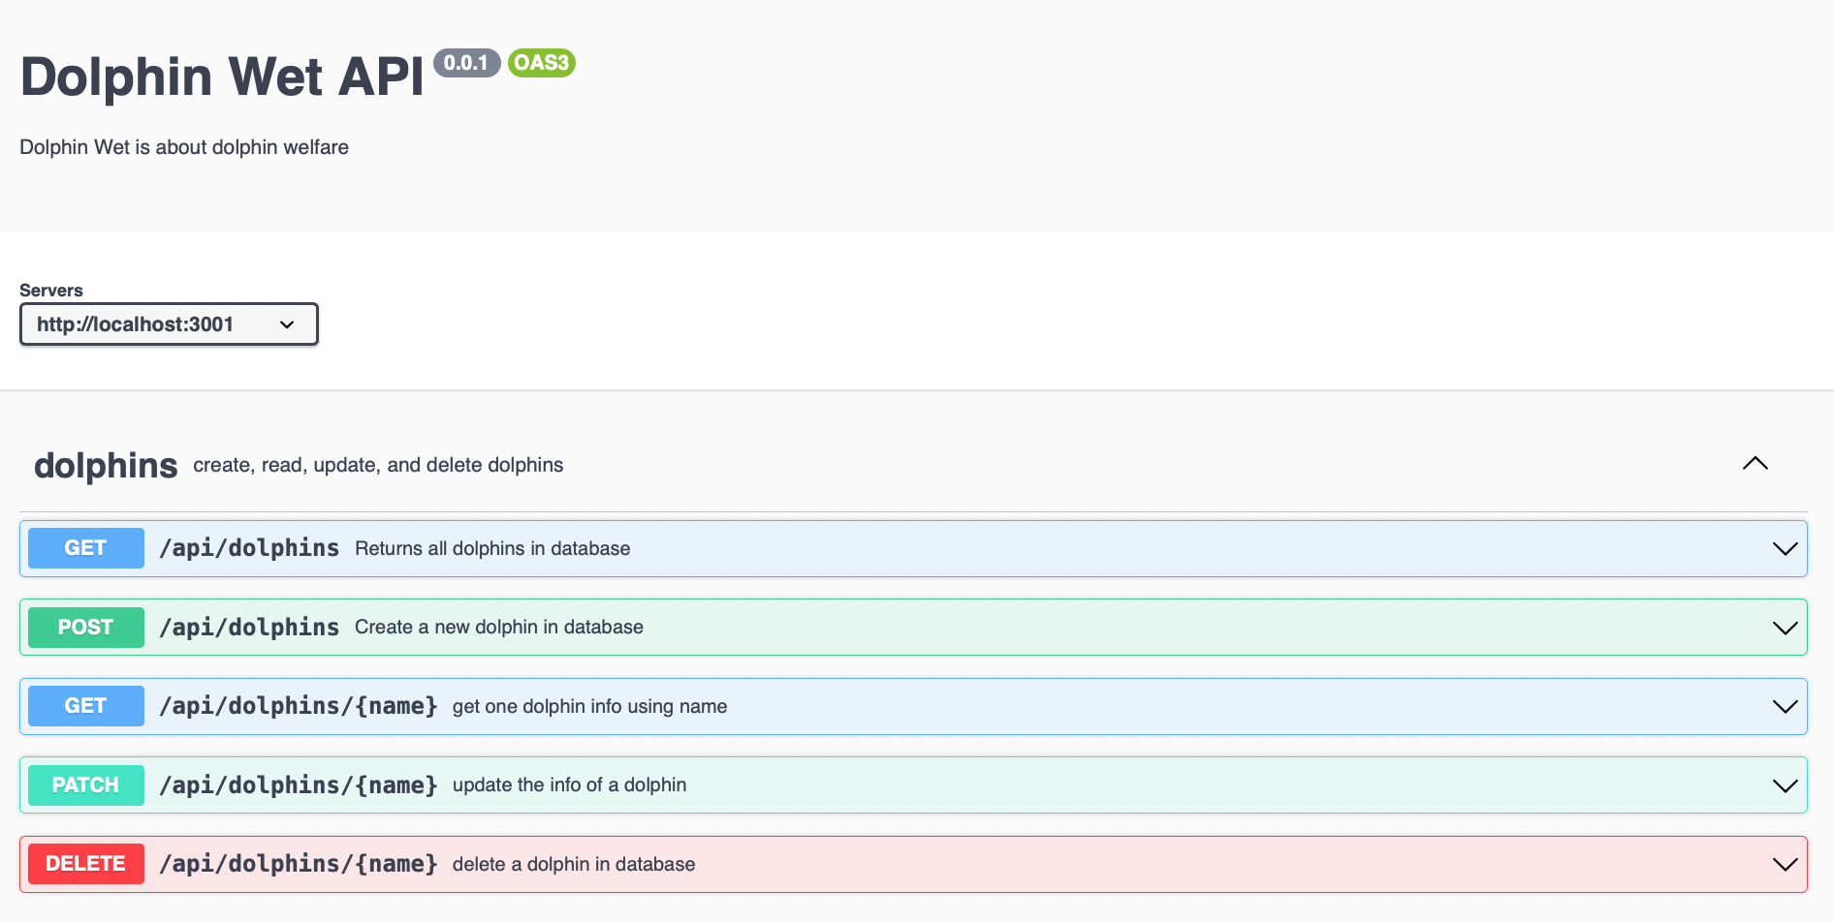
Dolphin Wet API
API documentation in DOLIMO

Slide 29
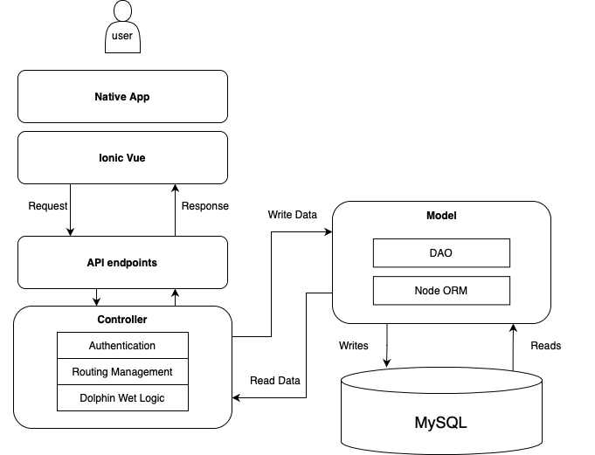
Overall architecture

Slide 30
Thank You for Your Attention!

